Slide 1
Model-Based Neuroscience
& Cognition
Summer School
2026
Niek Stevenson

Slide 2
Joint models

Slide 3
Joint models
Model that links data from multiple modalities
Different data sets
Behavior-fMRI
Behavior-EEG

Slide 4
Joint models
Model that links data from multiple modalities
Different data sets
Behavior-fMRI
Behavior-EEG
A formal model-based link between modalities

Slide 5
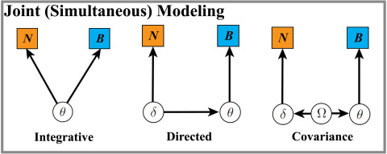
Joint models
Model that links data from multiple modalities
Different data sets
Behavior-fMRI
Behavior-EEG
A formal model-based link between modalities
Turner et al.

Slide 6
Joint Models
A formal model-based link between modalities

Slide 7
Joint Models
A formal model-based link between modalities
A statistically principled link between modalities:
Joint models: include the hypothesis in the model to propagate uncertainty

Slide 8
Behavior-behavior joint models

Slide 9
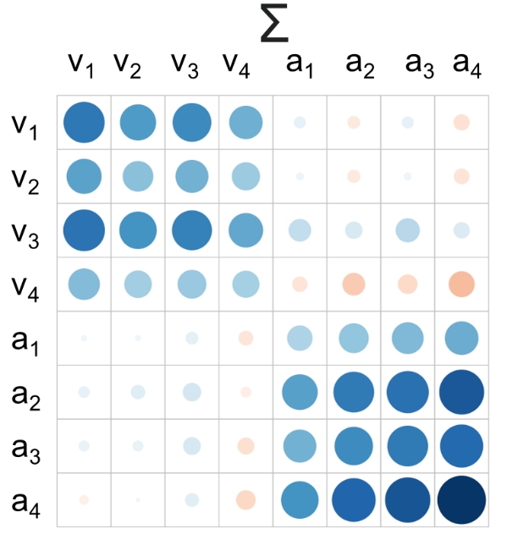
Behavior-behavior joint models

Slide 10
Behavior-behavior joint models
Theory driven
v ~ stimulus*task (only drift rates differ by task)
Correlate v1 with v2
Strong assumption that model is otherwise equivalent

Slide 11
Behavior-behavior joint models
Theory driven
v ~ stimulus*task (only drift rates differ by task)
Strong assumption that model is otherwise equivalent
Correlate v1 with v2
Agnostic
Drift rates on task 1 correlate with learning rate on task 2
Works with completely different task models
Commensurability is important! *Theory driven is ‘nested’ in Agnostic, they live on a continuum

Slide 12
EEG joint models
Either very easy:
v ~ EEG v_{it} = v0_{i} + B_{i}*EEG_{it} (subject i, trial t)
Or very hard:
v_{it} = v0_{i} + B_{i}*z_{it} EEG_{it} ~ N(z_{it,} σ_{ei}²) z_{it} ~ N(m_{i,} σ_{i}²)
This accounts for measurement error in the EEG (Ghaderi-Kangavari et al., 2023)

Slide 13
fMRI joint models
Hard:
Joint at the covariance matrix
Estimate fMRI GLM and cognitive model simultaneously
Harder:
Joint at the trial-level (and covariance matrix)
Requires trial-level fMRI mapping

Slide 14
Hierarchical models
Account for uncertainty at all data-levels

Slide 15
Hierarchical models
Account for uncertainty at all data-levels
Two-step model ignores uncertainty in participant level estimates

Slide 16
Hierarchical models
Account for uncertainty at all data-levels
Two-step model ignores uncertainty in participant level estimates
That unaccounted variance dilutes relationship estimates:
attenuation

Slide 17
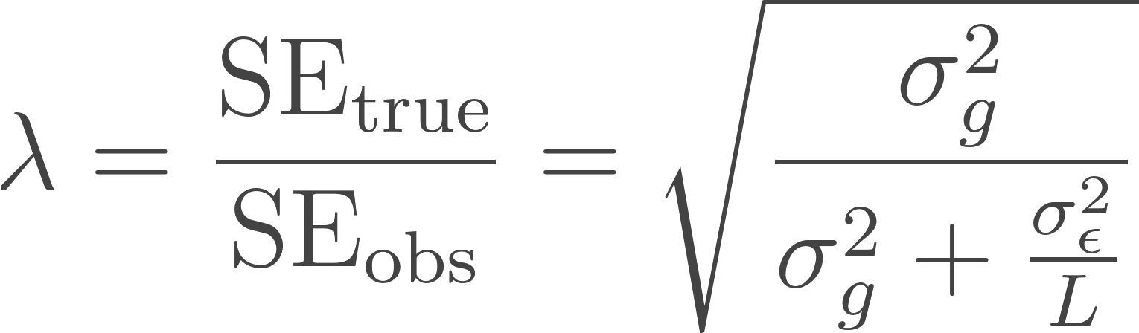
Attenuation factor
How much lower is my two-step estimate?
With L number of trials

Slide 18
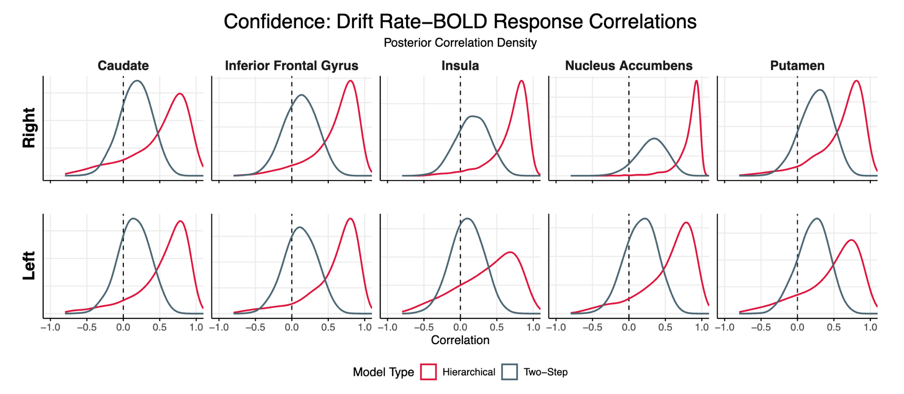
Attenuation factor
Shows up everywhere
In fMRI-behavior joint models:

Slide 19
Attenuation factor
Shows up everywhere
In fMRI-behavior joint models
In behavior-behavior joint models
Also in trial-wise brain links!

